Slide 1

PROJECT PROGRESS REPORT
Feng Xiangyu
Standing Jordan
Mamaladze Tsira

Slide 2
MAIN IDEAS
Bubble Tea Shop
Christmas Event
Potluck

Slide 3
TEAM MEMBER ROLES
Jordan
Feng
Tsira
Home page
Shop
Events & Gifts
FAQ
Catering
Contact Us

Slide 4
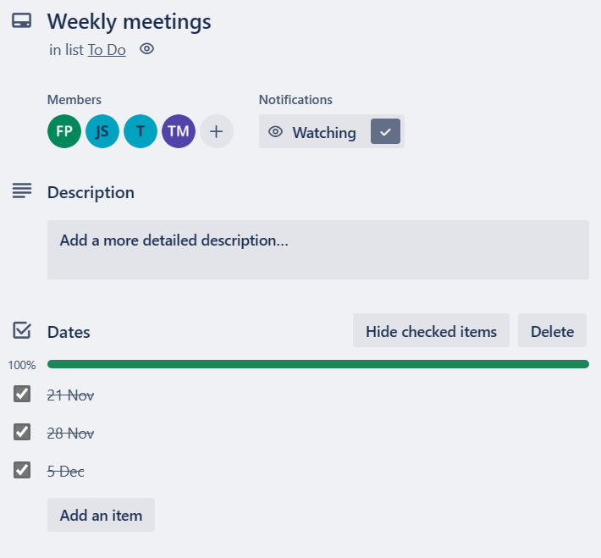
SCHEDULE
1st Meeting: Brainstorming, Project Planning, Analysis Of Requirements And Criteria, Choose The Color Theme For Our Website.
2nd Meeting: Sharing Progress, Choose The Style Of Navigation Bar, Shapes.
3rd Meeting: Share Progress, Merge Plan, PPT Plan.

Slide 5
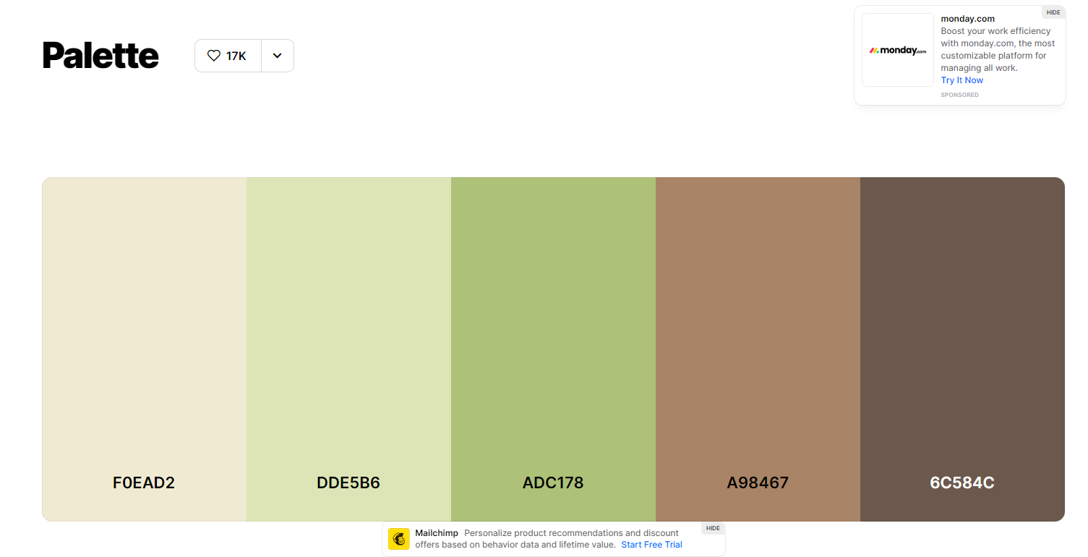
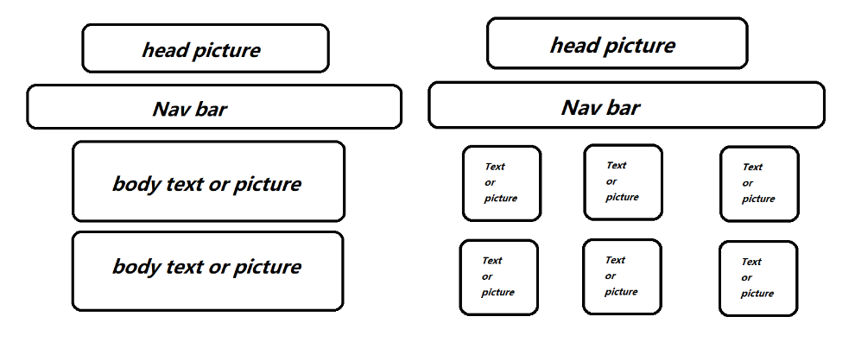

THE WEBSITE DESIGNING APPROACHES
COLORS
DESIGN LAYOUTS

Slide 6
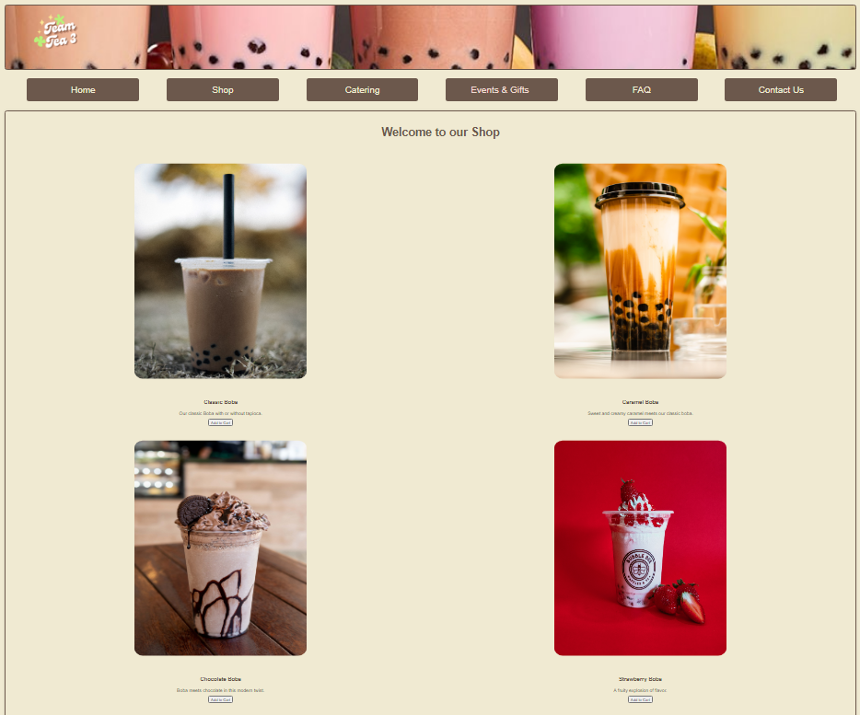
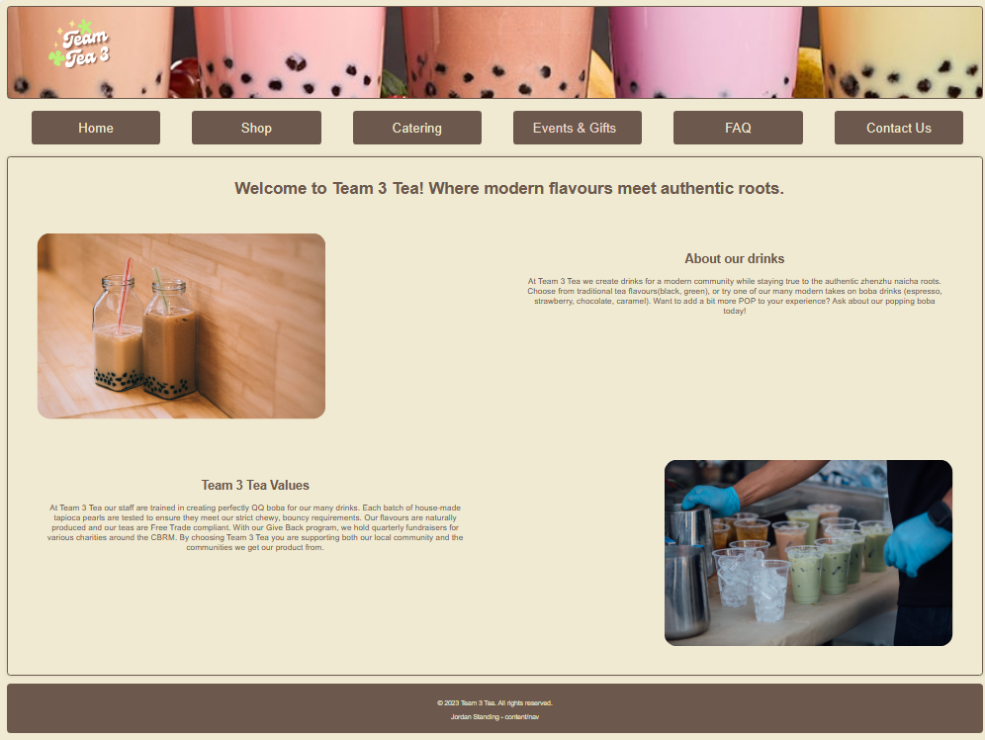
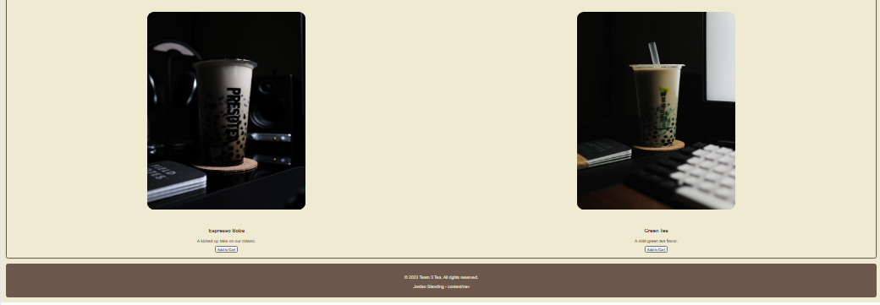
DEMO

Slide 7
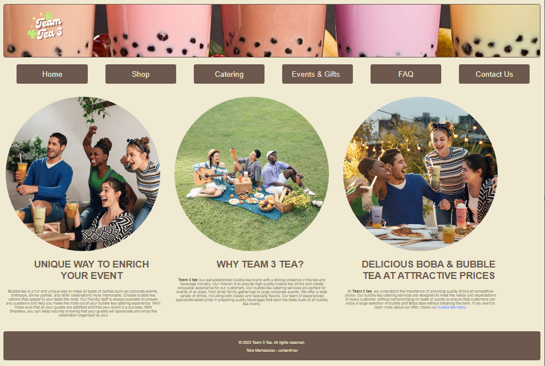
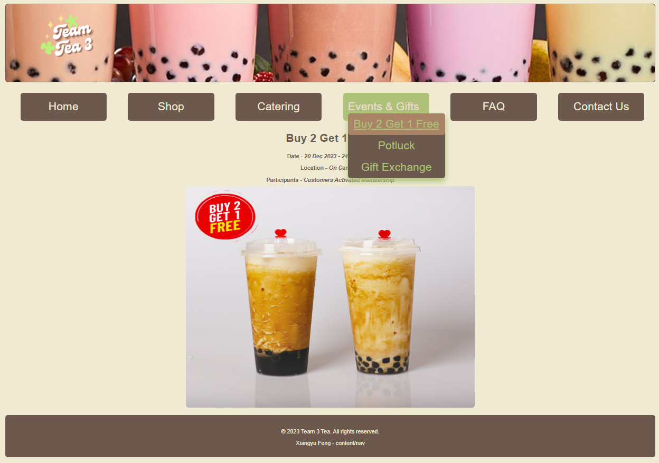
DEMO

Slide 8
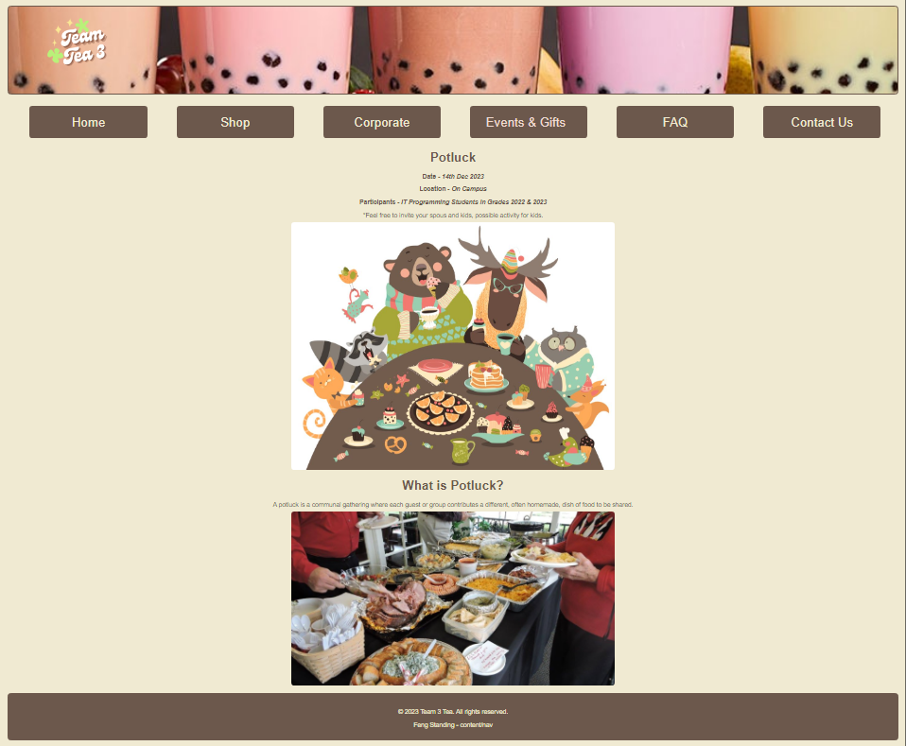
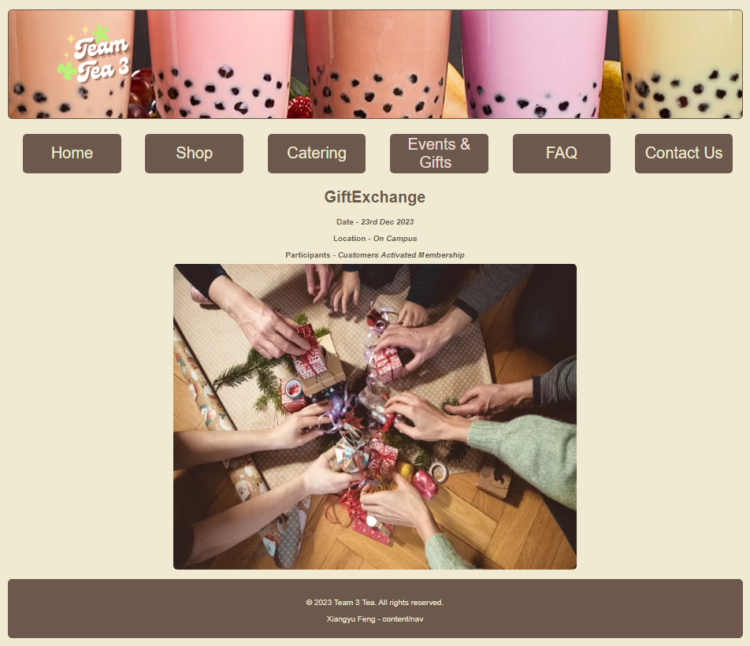
DEMO

Slide 9
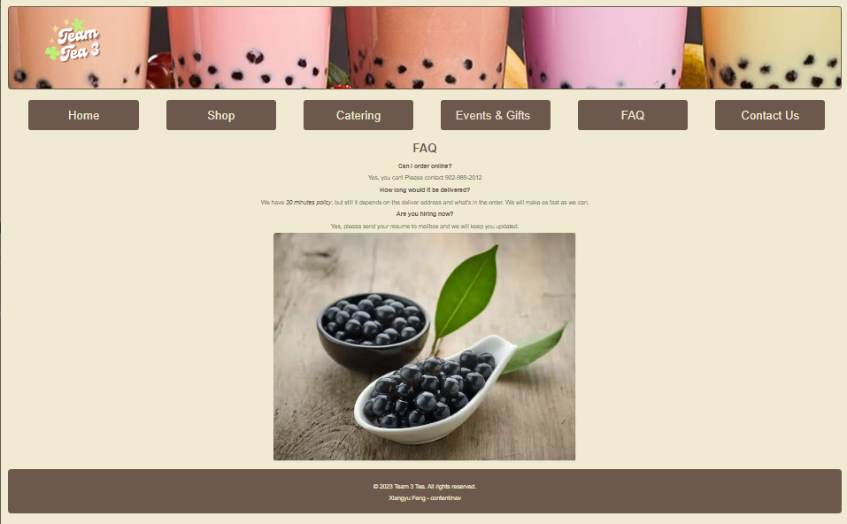
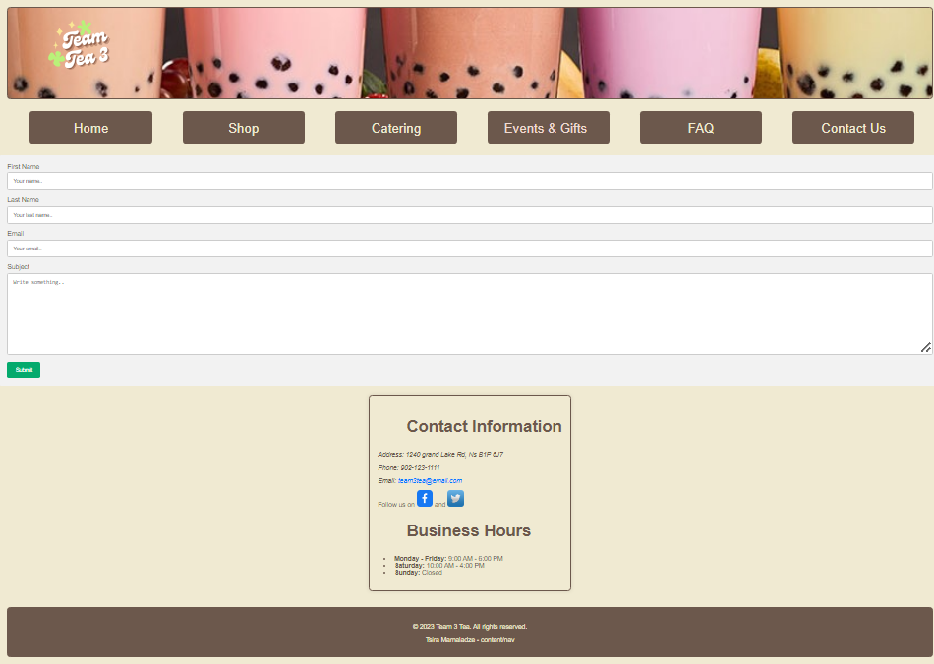
DEMO

Slide 10
RESOURCES
W3SCHOOL
MDN WEB DOCS
STACKOVERFLOW
UNSPLASH
COOLERS

Slide 11
RETROSPECTIVE
What Went Wrong
Font Colors were too light
Navigation Bar dropdown menu issues
Merging Issues: font and logo alignments, CSS citation.
What Went Well
Project Plan
Teamwork
Merging Process

Slide 12
THANK YOU!

